Slide 1








PLAYER 1
PLAYER 2
FROM NUMBERS TO PIXELS

Slide 2






1
TEAM
OUR MEMBERS:
KEEGAN
ANAS
PARSHVI
HUSAIN
SHITIZ

Slide 3



2
INTRODUCTION
MAthematics plays a crucial role in game develolment, shaping everything from character movement to ai behaviour and graphical effects.
in this presentation, we explore how key mathematical concepts are applied in game design and development.
these concepts enable developers to create realistic, engaging, and optimized gaming experiences.
CALCULUS
FRACTALS
LINEAR ALGEBRA
OPTIMIZATION
PROBABILITY

Slide 4

3
OBJECTIVES
TO UNDERSTAND THE WORKING AND APPLICATIONS OF DIFFERENT MATHEMATICAL CONCEPTS IN GAME DESIGN AND DEVELOPMENT
TO UTILIZE THE CONCEPTS WE’VE LEARNT TO CREATE SIMPLE DEMONSTRATIONS SHOWCASING THE CONCEPTS

Slide 5
4
LIBRARIES USED
PYGAME
A PYTHON LIBRARY FOR CREATING 2D GAMES AND SIMULATIONS.
Used to build interactive demos that showcase mathematical concepts in action (like geometry, vectors, and motion).
Allows precise control over visuals and game mechanics to demonstrate how math powers game design.
STREAMLIT
A PYTHON FRAMEWORK FOR CREATING INTERACTIVE WEB APPS.
Used to build a clean, user-friendly interface for displaying the demos and explanations.
Great for showcasing visualizations, sliders, and live code outputs to help explore math ideas dynamically.

Slide 6







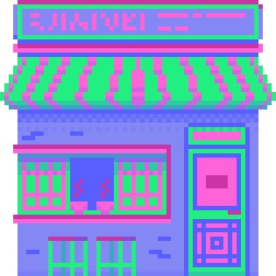
5
CALCULUS

Slide 7
6
CALCULUS
CALCULUS PLAYS A CRITICAL ROLE IN MODERN GAME DEVELOPMENT. IT RANGES FROM SIMULATING REALISTIC MOTION TO CREATING LIFELIKE LIGHTING EFFECTS.
KEY CONCEPTS:
1]DERIVATIVES
2]INTEGRALS
Academic studies in game physics and graphics show how calculus is essential for simulation and rendering in games.

Slide 8
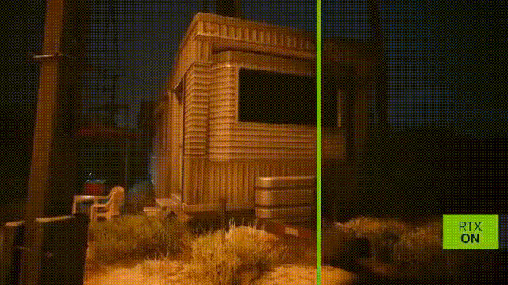
7
MOTION AND LIGHTING
MOTION SIMULATION:
1] DERIVATIVES CALCULATES CHANGE IN MOTION
2] NUMERICAL INTEGRATION UPDATES POSITIONS FRAME-BY-FRAME.
LIGHTING AND RAY TRACING:
1] INTEGRALS SOLVE THE RENDERING EQUATION.
2]DERIVATIVES COMPUTE SURFACE NORMALS FOR ACCURATE SHADING.

Slide 9

8
FRACTALS

Slide 10
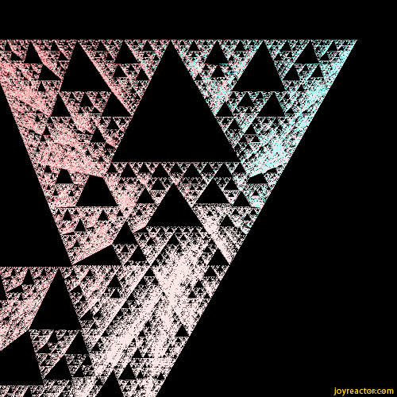
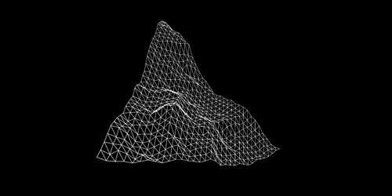
9
WHAT ARE FRACTALS?
FRACTALS ARE COMPLEX PATTERNS THAT REPEAT AT DIFFERENT SCALES, SHOWING SELF-SIMILARITY.
THEY ARE MATHEMATICALLY GENERATED BUT LOOK NATURAL.
USED IN COMPUTER GRAPHICS TO CREATE REALISTIC TEXTURES, TERRAINS, AND EFFECTS IN VIDEO GAMES.

Slide 11
10
MATH BEHIND FRACTALS
1. RECURSION
Fractals use recursive rules where a function calls itself with smaller inputs.
Example: A fractal tree forms by repeatedly splitting branches.
2. Iterative Formulas
Fractals can be generated by applying a rule repeatedly.
Example: The Mandelbrot Set follows zn+1=zn2 + c (with complex numbers).
3. Fractional Dimension
Unlike regular shapes, fractals have non-integer dimensions (e.g. 1.26, 1.58).
Formula: D=log⁡(N)/-log⁡(S), where N is self-similar parts, and S is the scaling factor.

Slide 12
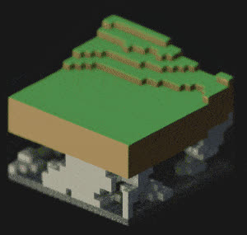
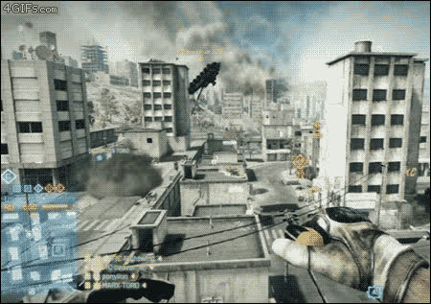
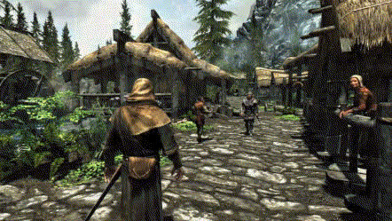
11
Procedural Terrain Generation
Minecraft and No Man’s Sky use fractals to create vast, explorable worlds.
APPLICATION OF FRACTALS IN VIDEO GAMES
Natural Textures and Effects
Frostbite Engine uses fractals for realistic environmental effects such as clouds, fire and smoke.
Immersive Environments
Games like The Elder Scrolls V: Skyrim use fractals for realistic landscapes.

Slide 13
12
LINEAR ALGEBRA

Slide 14

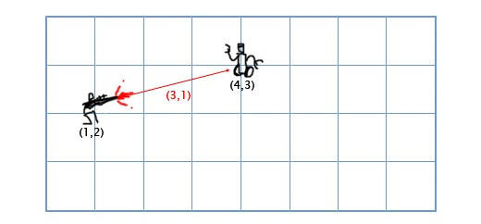
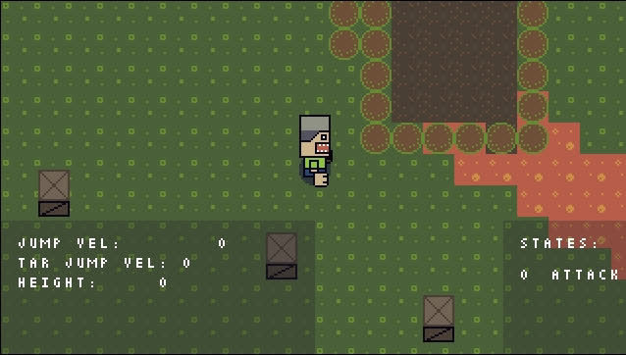
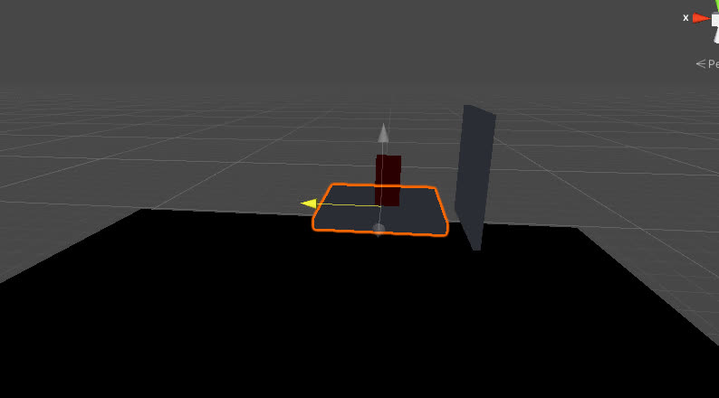
13
For bullets,
Bullet position = Player position+(aim direction × bullet speed * Δt)
VECTORS
For Movement,
New Position = Current Position+ (move direction × Speed × Δt)
For hit detection,
A · B = |A| × |B| × cos(θ)

Slide 15
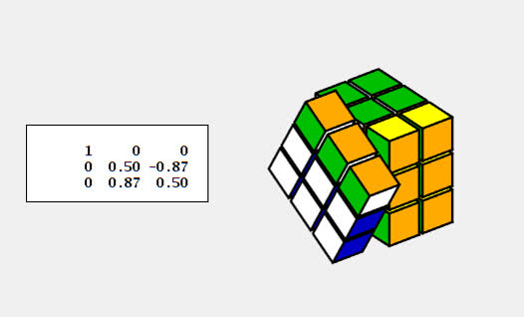
14
MATRICES
For rotation matrix,
For translation matrix,
[Cos Θ - Sin Θ 0]
{Sin Θ CosΘ 0]
[0 0 1]
[1 0 tx]
[0 1 ty]
[0 0 1 ]
For scaling matrix,
[Sx 0 0]
[0 Sy 0]
[0 0 1]

Slide 16
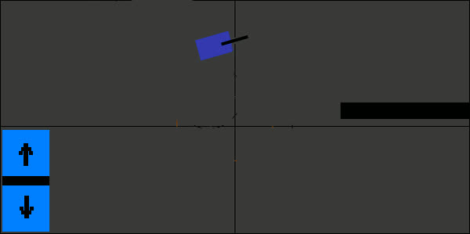
15
MATRICES
For rotation matrix,
For translation matrix,
[Cos Θ - Sin Θ 0]
{Sin Θ CosΘ 0]
[0 0 1]
[1 0 tx]
[0 1 ty]
[0 0 1 ]
For scaling matrix,
[Sx 0 0]
[0 Sy 0]
[0 0 1]

Slide 17
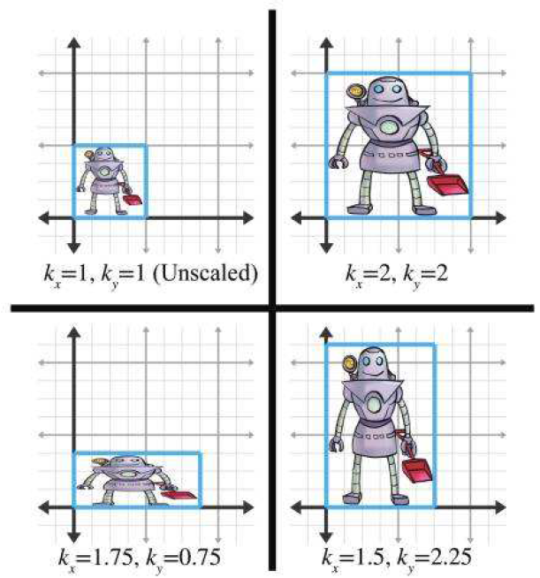
16
MATRICES
For rotation matrix,
For translation matrix,
[Cos Θ - Sin Θ 0]
{Sin Θ CosΘ 0]
[0 0 1]
[1 0 tx]
[0 1 ty]
[0 0 1 ]
For scaling matrix,
[Sx 0 0]
[0 Sy 0]
[0 0 1]

Slide 18

17
OPTIMISATION

Slide 19

18
WHAT IS OPTIMISATION
In simple terms, optimization is about finding the ideal choice, given certain constraints and goals.
in gaminG, IT refers to applying mathematicaL principles to make the best possible decisions, LIKE FINDIND THE OPTIMAL/MOST COST-EFFECTIVE PATH, welL within a game's rules.
it can be DONE to achieve a goal-or to simply win.
eg. maximizing efficiency OR PRIZE WON.
minimizing losses OR TIME TAKEN.

Slide 20
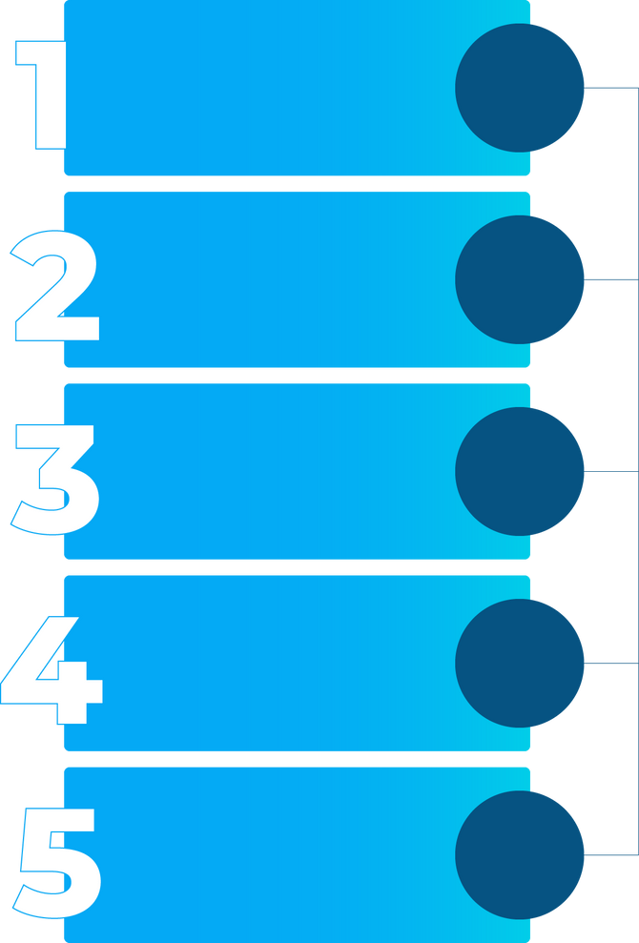
19
CONCEPTS USED
OPERATIONS RESEARCH
MAXIMIZING DAMAGE OUTPUT GIVEN RESOURCE CONSTRAINTS.
REPRESENTED BY LINEAR EQUATIONS OR INEQUALITIES.
GAME THEORY
INVOLVES STRATEGIC DECISION-MAKING.
PREDICTING OPPONENT BEHAVIOR AND COUNTERING IT.
PATHFINDING ALGORITHMS
OPTIMIZATION ENSURES AI MAKES "SMART" MOVES.
DONE USING A* ALGORITHMS.
EXPECTED VALUE
USED TO DETERMINE THE BEST CHOICE UNDER UNCERTAINTY.
GRAPH THEORY
USED FOR PATHFINDING.
HELPS FIND SHORTEST OR LEAST-COST PATHS IN GAMES.

Slide 21
20
GIVES COMPETITIVE ADVANTAGE
ENHANCES PLAYER SATISFACTION
WHY IT MATTERS
MAXIMISES VALUE
SAVES TIME
ENCOURAGES STRATEGIC THINKING
IMPROVES PERFORMANCE

Slide 22

21
PROBABILITY AND STATISTICS

Slide 23
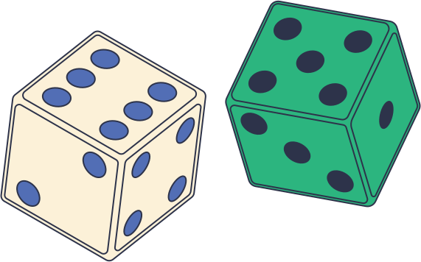
22
PROBABILITY AND STATISTICS
What is Probabilty
PROBABILITY IS THE LIKELIHOOD OF AN EVENT OCCURRING.
IT INFLUENCES RANDOMNESS, FAIRNESS, AND PLAYER DECISION-MAKING.

Slide 24

22
PROBABILITY AND STATISTICS
What is Probabilty
HELPS ANALYZE PLAYER BEHAVIOR AND REFINE MECHANICS.
What is statistics
USED FOR GAME DIFFICULTY ADJUSTMENTS AND AI IMPROVEMENTS.

Slide 25

22
PROBABILITY AND STATISTICS
What is Probabilty
CREATES ENGAGING, UNPREDICTABLE GAMEPLAY.
What is statistics
ENSURES FAIRNESS & BALANCE IN GAME MECHANICS.
Why it matters

Slide 26
23
MATHEMATICAL CONCEPTS BEHIND PROBABILITY
UNIFORM DISTRIBUTION
NORMAL DISTRIBUTION
POISSON DISTRIBUTION
Every outcome has the same probability. Used in dice rolls (Monopoly), random enemy spawns, or simple loot systems.
Used when some outcomes are more likely than others, forming a bell curve
Common in sports games where player performance varies but stays within a predictable range.
Used to model rare events, such as finding legendary loot or Powerful weapons/Armor

Slide 27
24
MATHEMATICAL CONCEPTS BEHIND PROBABILITY
BAYESIAN PROBABILITY IN AI
RANDOM NUMBER GENERATORS
AI adapts to player behavior dynamically Ising Baye’s theorem.
Example: Game AI adjusts enemy difficulty based on player performance.
Used to calculate probability in loot drops, attack accuracy, enemy spawns,etc
Example: Pokémon’s accuracy system (90% hit chance = 9/10 hits).

Slide 28

25
HOW PROBABILITY IS USED IN GAMES
RANDOMNESS AND CHANCE EVENTS
AI BEHAVIOR & DECISION MAKING
GAME BALANCE & FAIRNESS
DICE ROLLS & CARD DRAWS
CRITICAL HITS AND DAMAGE CALCULATIONS
PAC-MAN GHOSTS
LOOTBOXES & ITEM DROPS
STRATEGY GAMES AI
MATCHMAKING & RANKING
PROCEDURAL GENERATION

Slide 29
26
FUTURE SCOPE
🔮 AI-Driven Storytelling
Upcoming games will use advanced probabilistic models to generate unique, adaptive storylines based on player choices—moving beyond static narratives.
🧠 Emotion-Aware Gameplay
Mathematical models combined with machine learning will soon interpret player behavior and emotions in real time, dynamically adjusting gameplay difficulty and events.
🌀 Next-Gen Procedural Worlds
Future procedural generation will use fractal math and chaos theory to create highly detailed, living game worlds that evolve with the player.
🧮 Math in Metaverse & AR/VR
As virtual spaces grow, linear algebra and geometry will become even more central—driving realistic spatial interaction, object manipulation, and immersive design.

Slide 30
27
CONCLUSION
Mathematics lies at the heart of modern game development, bridging abstract theory and creative design. Key concepts like fractals, probability, linear algebra, calculus, and optimization drive everything from procedural world generation and realistic physics to AI behavior and efficient performance.
As gaming technology advances—through AI, machine learning, augmented reality, and cloud computing—these mathematical principles are becoming even more essential. Far beyond solving technical challenges, math enables innovation, shaping immersive, dynamic, and personalized gaming experiences.
It is not just a support tool, but a creative force powering the future of interactive entertainment.

Slide 31
28
REFERENCES
Gharehchopogh, Farhad Soleimanian, Isa Maleki, and Sahar Sadouni. "Analysis of the Fractal Koch Method in Computer Games Development." International Journal of Computer Graphics & Animation (IJCGA) Vol 4 (2014).
Cristea, Adrian, and Fotis Liarokapis. "Fractal nature-generating realistic terrains for games." 2015 7th International Conference on Games and Virtual Worlds for Serious Applications (VS-Games). IEEE, 2015.
Pramuditya, S. A., and H. Sulaiman. "Development of instructional media game education on integral and differential calculus." Journal of Physics: Conference Series. Vol. 1280. No. 4. IOP Publishing, 2019.
Alvarado, Alberth, Roberto Portillo, and Joaquín Marroquín. "Design and Implementation of Calc-ONE: A Gamified Approach to Reinforce Calculus Concepts." 2024 IEEE Frontiers in Education Conference (FIE). IEEE, 2024.
Mauntel, Matthew, and Michelle Zandieh. "Forms of Structuring Space by Linear Algebra Students with Video Games and GeoGebra." International Journal of Research in Undergraduate Mathematics Education (2024): 1-27.
*REMAINING RESEARCH PAPERS ARE MENTIONED IN THE REPORT

Slide 32
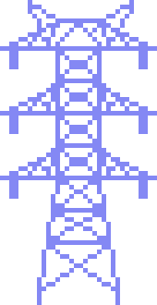


THANK
YOU!

